Slide 1
Dynamic Weather Dashboard
CAPSTONE PROJECT
Presented By:
1. Priyanshu Roy-Netaji Subhash Engineering College-Information Technology

Slide 2
OUTLINE
Users need real-time, location-based weather data in a simple interface.
Built using HTML, CSS, and JavaScript, Integrated OpenWeatherMap and Geolocation APIs, Used Fetch API to get and display live weather data, Responsive design for seamless user experience.
Detect user’s location via Geolocation API. Fetch weather data using OpenWeatherMap API. Parse JSON data for temperature, humidity, and forecast. Update dashboard dynamically using JavaScript. Display real-time results with interactive UI.
Displays live temperature, humidity, and weather conditions. Auto-detects user location instantly. Provides a clean, interactive weather dashboard.
Real-time weather data enhances convenience and planning. Combines APIs and web technologies effectively. Demonstrates efficient use of geolocation and data visualization.
Add voice assistant support. Include severe weather alerts. Provide 7-day forecast visualization. Enable multi-language and offline mode.
OpenWeatherMap API – https://openweathermap.org/api , MDN Web Docs – Geolocation API – https://developer.mozilla.org/en-US/docs/Web/API/Geolocation_API , CSS-Tricks – Responsive Web Design Basics – https://css-tricks.com

Slide 3
Problem Statement
Users often struggle to access accurate and real-time weather information in one place
Many existing weather apps are cluttered or difficult to navigate, especially for casual users.
There is a need for a simple, location-based weather dashboard that provides instant data like temperature, humidity, and forecasts.
The system must be lightweight, visually clear, and easy to use, enhancing travel planning and daily convenience.

Slide 4
System Approach
Frontend Technologies:
HTML5-Defines the structure and layout of the weather dashboard.
CSS3-Handles styling, layout responsiveness, and visual aesthetics.
JavaScript (ES6)-Enables dynamic data fetching, DOM manipulation, and API integration.
OpenWeatherMap API-Provides real-time weather data (temperature, humidity, conditions, forecasts).
Geolocation API-Detects and fetches weather details of the user’s current location.
Design Approach:
Clean and minimal interface for clear visibility of weather parameters.
Responsive design optimized for both desktop and mobile devices.
Modular architecture separating HTML, CSS, and JS for maintainability.
User-centric interaction flow focusing on quick location detection and instant results.

Slide 5
Algorithm & Deployment
1. Data Fetching
Connect to the OpenWeatherMap API using the city name or user’s geolocation.
Fetch real-time weather data such as temperature, humidity, wind speed, and conditions.
2. Data Processing
Parse the API response in JSON format.
Extract and format key weather parameters for user-friendly display.
3. Frontend Design
Structure the webpage using HTML5.
Apply CSS3 for layout, color themes, and responsiveness.
Implement icons and visuals for weather conditions (sunny, rain, clouds, etc.).
4. Interactivity & Functionality
Use JavaScript to update weather data dynamically without page reload.
Integrate Geolocation API to auto-detect the current location.
Add search functionality to fetch weather by city name.
Display alerts or messages for invalid inputs or API errors.
5. Testing
Verify accuracy of weather data from API responses.
Ensure responsiveness on different devices and screen sizes.
Test cross-browser compatibility (Chrome, Edge, Firefox).
6. Deployment
Host the project using GitHub Pages or Netlify for public access.
Ensure API key security through environment variables (if possible).

Slide 6
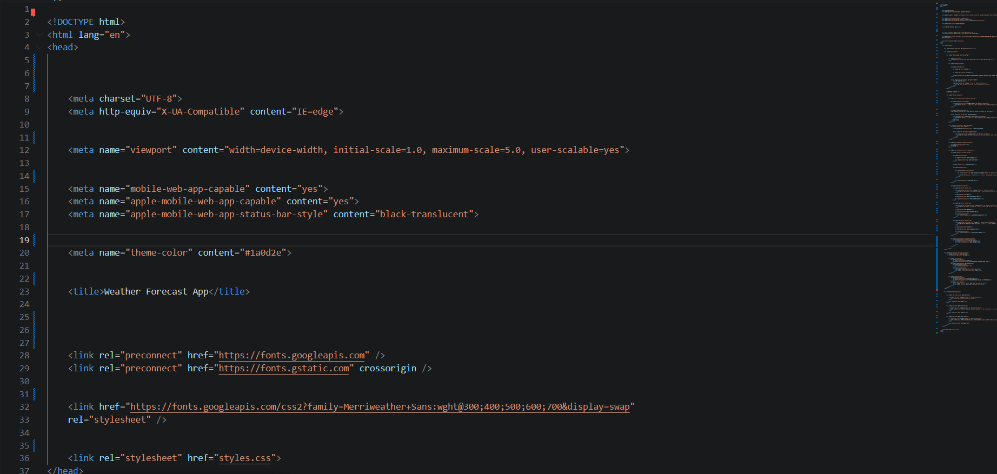

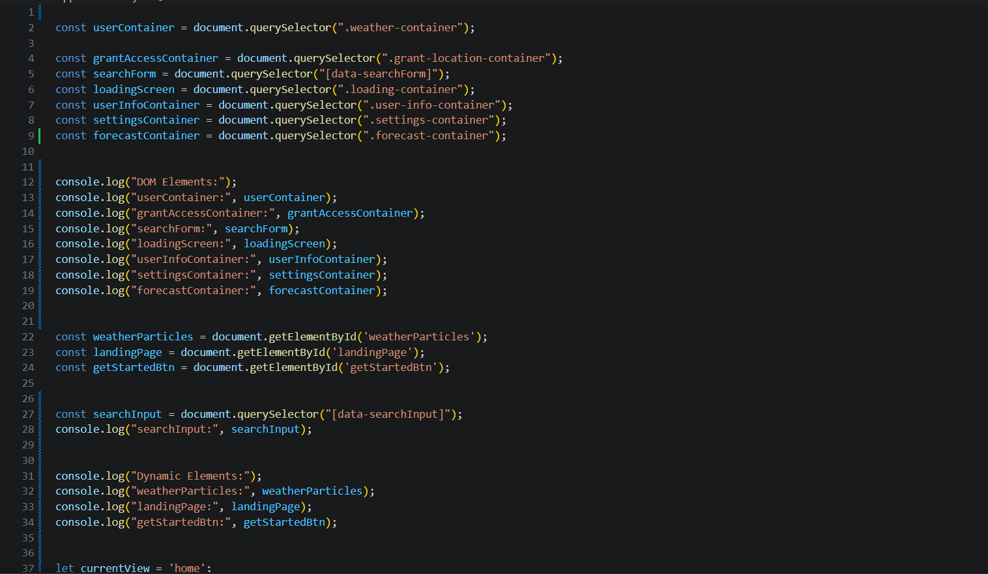
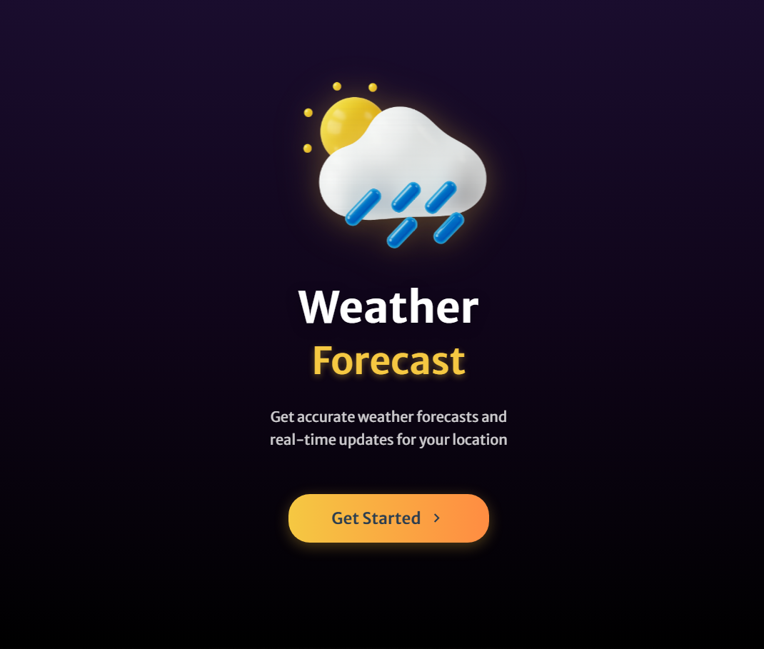
Result

Slide 7
GITHUB AND DEPLOYMNET LINK
Attach your Github Link : priyanshu-creates/nimbus-
Deployment link: Weather Forecast App

Slide 8
Conclusion
The Dynamic Weather Dashboard successfully delivers real-time, location-based weather updates in a simple interface.
It provides accurate temperature, humidity, and forecast data using OpenWeatherMap API.
The responsive and intuitive design ensures seamless accessibility across all devices.
By integrating Geolocation and search features, it enhances user convenience and decision-making for travel and daily planning.
Overall, the project demonstrates an effective blend of frontend technologies and API integration for real-world usability.

Slide 9
Future scope(Optional)
Integrate backend using Node.js for efficient order and data management.
Implement a secure payment gateway to enable safe online transactions.
Develop an admin dashboard for product and inventory updates.
Incorporate AI-driven weather prediction and personalized user recommendations.
Add voice and notification support for real-time weather alerts and updates.

Slide 10
References
OpenWeatherMap API — Official API docs for current weather, One Call, and geocoding (used for real-time data). (https://openweathermap.org/api)
MDN Web Docs — Geolocation API — Browser geolocation usage and best practices (used for location detection). (https://developer.mozilla.org/en-US/docs/Web/API/Geolocation_API)
MDN Web Docs — Fetch API — Reference for HTTP requests and response handling in JavaScript (used for API calls). (https://developer.mozilla.org/en-US/docs/Web/API/Fetch_API)
Bootstrap v5.3 — Get started with Bootstrap — Layout and responsive utilities (optional UI framework for rapid responsive design). (https://getbootstrap.com/docs/5.3/getting-started/introduction/)
GitHub Pages Documentation — Guide for deploying static sites from GitHub (recommended for free hosting). (https://docs.github.com/en/pages)
Netlify Docs — Deploying Sites — Easy static-site deployment and continuous deploy from Git repos. (https://docs.netlify.com)
“Progressive Web Apps” (Google Developers) — Patterns for offline caching, service workers, and PWAs (useful if adding offline support). (https://developers.google.com/web/progressive-web-apps)
OWM Icon Reference — OpenWeatherMap icon endpoints and usage for displaying weather icons. (https://openweathermap.org/weather-conditions)
Priyanshu Roy / Nimbus Weather App— GitHub repository referenced by user (project/portfolio examples). (priyanshu-creates/nimbus-)
CSS-Tricks — Responsive Design Basics — Practical tips on responsive layout and CSS best-practices. (https://css-tricks.com/snippets/css/complete-guide-grid/)

Slide 11
THANK YOU

